Slide 1
JSC270 Assignment 4 Presentation
Mohsin Reza, Wei Yu, You Peng

Slide 2
Problem Description and Motivation
Main Question: Can we predict the number of followers a twitter user has based on the contents of their tweets?

Slide 3
Description of the data
2000 observations
2 features (text, number of followers)
Excluded retweets, collected 2000 tweets since March 10. No other search parameters uses
Limitations: more tweets -> more accurate result

Slide 4
Exploratory Data Analysis
Low number of followers = 0 - 1000
Medium number of followers = 1001 – 10000
High number of followers = > 10000
Created a labels column to represent this
Mean of 580 followers
Preprocessing: removed tags, punctuation, remove stopwords, lemmatize

Slide 5
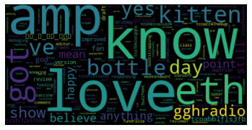
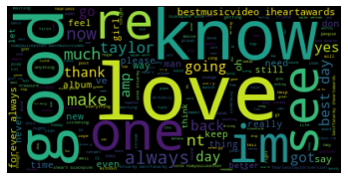
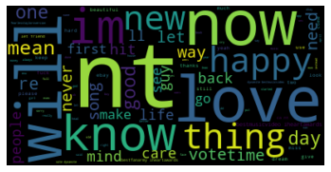
Word Clouds!
Word cloud for high number of followers
Word cloud for medium number of followers
Word cloud for low number of followers

Slide 6
Machine Learning Model – Naive Bayes
Preprocessing
Fit Model
Split the data into training and testing
Guess the probability of each label, choose the highest
Check accuracy
Use model to predict testing data
Measure accuracy by checking proportion of correct predictions
Remove punctuation, tags, create tokens, etc.
Create tokens, stemming and lemmatization

Slide 7
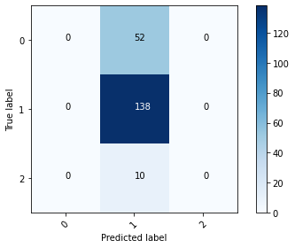
Results and Conclusions
Number of tweets in the dataset | Accuracy of out Naïve Bayes Model
20 | 100%
100 | 80%
500 | 69%
1000 | 69%
2000 | 75.5%

